Slide 1

Effective Leadership to
Implement Change
Ellen and John Correll
NAPSA Conference
October 16-17, 2018

Slide 2

“It must be realized that there is nothing more difficult to plan, more uncertain of success, or more dangerous to manage than the establishment of a new order of things. For he who introduces change makes enemies of all who derived advantage from the old order and finds lukewarm defenders among those who stand to gain from the new one.”
Machiavelli (1502)

Slide 3
Agenda
•Introductions
•Approaches to Successful Change
•Personal Examples of Change
•Models of Change Management
•Leadership Required to Implement Successful Change
•Outline for Successful Change: Personal or Professional

Slide 4

What does “Change” mean to you?

Slide 5

Desired Outcomes of Workshop
To better understand key principles of change and leadership models to best implement a desired successful change process-personal or professional.

Slide 6

The Illusion of the Broken System
•Common myth driving change initiatives: We need to change because something is broken
•Reality is: It is the way it is because the people in that system want it that way
•Bottom line: There is no such thing as a dysfunctional organization, because every organization is perfectly aligned to achieve the results it currently gets

Slide 7

7 Organizational “Change” Busters
•We don’t do it that way here
•That will never work…
•We tried that already
•That’s out of our scope
•It’s not in our budget
•We’ve never done that before
•We don’t have time

Slide 8

Clarity of Strategy
Successful change processes are a function of shaping and reshaping good ideas as they build capacity and ownership.

Slide 9
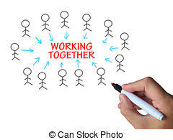
Group Work
Personal Examples of Change
•Individually consider two “changes” you have been involved with. Think of an example that went well and one that didn’t-
Why was one successful? Why was one not successful?
•Small group comparisons- List characteristics for both on chart paper
•Report out to group

Slide 10

Change
What will it look like?
What will we observe?
What will we hear people talking about?

Slide 11

Needed to Manage Change
•Vision
•Skills
•Incentives
•Resources
•Action Plan
And…..Communication!

Slide 12
Components of Successful Change (NAPSA 10/16)
-Use data for decision making -Involve stakeholders
-Appropriate training -Follow-up
-Mentoring -Admin/District Support
-Provide some autonomy -Stay focused by change if needed
-Fluidity -Communication
-Establish trust -Small increments
-Develop consensus -Provide resources

Slide 13
Components of Successful Change (NAPSA 10/16)
-Use surveys/gather feedback -Job embedded
-Clear expectations -Carefully consider timing
-Staff buy-in -Provide incentive for the change
See change through to the end -See the whole picture
-Be clear on the problem to be solved

Slide 14
Characteristics of Unsuccessful Change (NAPSA)
- No follow-through -Lack of training, time, effort
-Poor communication -Too many changes, too often
-Lack of tools -Lack of policies and supports
-Not training new staff on changes -Group does not understand what or why
-Top down/unilateral approach -Do not understand real problem
-Unfocused approach -Lack of follow-through
-Admin apathy -Lack of direction

Slide 15
Characteristics of Unsuccessful Change (NAPSA)
-Mistrust -CAVE dwellers aplenty
-Inertia -One time presentation
-Limited stakeholders -Lack of specific outcomes

Slide 16
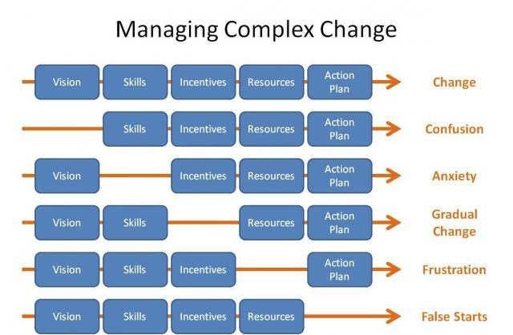

Slide 17

Change Friendly Leadership- Rodger Duncan
(System View)
1. Validate the journey
2. Scan for speed bumps
3. Chart the course
4. Build a coalition
5. Ford the streams
6. Stay on message
7. Mind the gap

Slide 22

Michael Fullan on Change (System View)
•Secure the vision
•Build the Culture
•Determine the resources needed
•Develop needed skills
•Focus on the change design
•Cultivate coherence
•Confront Distractors
•Align Resources for Sustainability

Slide 23

Five Stages of Change:
Garmston and Wellman (System View)
•1. Accept the Reality
•2. Owning the Problem
•3. Owning the Solution
•4. Implementing the Change
•5. Monitoring and Evaluating

Slide 24
Kotter’s Eight Steps to Successful Organizational Change (System View)
-Create an environment of urgency-help all to understand the need for change.
-Develop a team with shared ownership to plan for, lead, and manage the change
-Develop and share the vision- how things will look as a result of the change.
-Articulate and frequently come back to the vision.
-Remove obstacles and empower people to implement the change.
-Create, celebrate, and sustain short term “wins.”
-Don’t give up or let up!
-Don’t sit back-will need to constantly reinforce the changes so they stick.

Slide 25

For change to be sustainable
you need to address feelings.

Slide 26

Concerns Based Adoption Model (Personal View)
•Awareness- I am not concerned about it
•Informational- I’d like to know more
•Personal- How will it affect me?
•Management- I’m bogged down with it
•Consequence- How is it affecting others?
•Collaboration- How can I work with others?
•Refocusing- I have some ideas to improve it

Slide 27
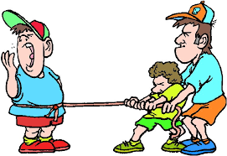
Resistance is not necessarily a sign of disloyalty or of not being a team player.
You need to identify and manage resistance to your change effort.

Slide 28


What would genuine commitment to this change look like in actual practice?

Slide 29

Communication
The single biggest problem in communication is the illusion that it has taken place.

Slide 30

Give people information and do it again, again and again
What is the situation that requires this change to solve it?

Slide 31

Communication
•Success reports
•Talk honestly and openly about “speed bumps”
•Acknowledge if you have stubbed your toe
•What can we learn from mistakes

Slide 32

People don’t dare to stop doing anything. They try to do all of the old things and the new things

Slide 33

Question:
1. How do you put a giraffe into a refrigerator?

Slide 34
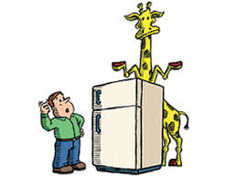
Answer:
Open the refrigerator and put in the giraffe, and close the door.
This question tests whether you tend to do simple things in an overly complicated way.

Slide 35

Question:
2. How do you put an elephant into a refrigerator?

Slide 36
Answer:
Did you say, “open the refrigerator, put in the elephant, and close the refrigerator?”
Correct answer:
Open the refrigerator, take out the giraffe, put in the elephant and close the door.
--This tests your ability to think through the repercussions of your previous actions.

Slide 37
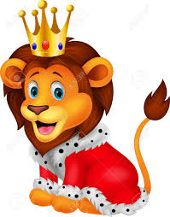
Question:
3. The Lion King is hosting an animal conference. All the animals attend except one. Which animal does not attend?

Slide 38

Answer:
The Elephant.
The elephant is in the refrigerator. You just put him there.
--This tests your memory.
OK, even if you did not answer the first three questions correctly, you still have one more chance to show your true abilities.

Slide 39

Question:
4. There is a river you must cross but it is inhabited by crocodiles. How do you manage it?

Slide 40

Answer:
You swim across.
All the crocodiles are attending the animal meeting.
--This tests whether you learn quickly from your mistakes.

Slide 41

What does “Leadership” mean to you?

Slide 42

Leadership or Management?
•Stagnant organizations need leadership
•Chaotic organizations need management

Slide 43

Bolman and Deal- Four Frameworks of Leadership
Structural:
Focus on the adjusting the structural elements of a work group regarding assignments of tasks, job responsibilities, reporting mechanisms, or position alignment- use when goals are clear but new structures/position assignments are needed to get work done

Slide 44

Human Resource:
Focus on people, their needs, support and empowerment of your team, professional development, and empowerment-use when morale may be low but there is little conflict

Slide 45

Political:
Focus on political and power relationships within and external to the organization-building power bases, coalitions and negotiating “deals” to get things done-use when resources are scarce and values are in conflict

Slide 46

Symbolic:
Focus on vision and inspiration; emphasize how contributions of team members fit in and support the master plan; focus on the importance of the mission of the organization-use when the overall mission of the organization and contributions to it are unclear

Slide 47
Levels of Leadership- Jim Collins
•Level 5- Executive
•Level 4- Effective Leader
•Level 3- Competent Manager
•Level 2- Contributing Team Member
•Level 1- Highly Capable Individual

Slide 48
John Maxwell on Leadership
•See everyone as a “10”
•Develop each team member as a person
•Place people in their strength zones
•Model the behavior you desire
•Transfer the vision
•Reward for results

Slide 49

Drucker on Leadership
•Get the Knowledge You Need
• Ask what needs to be done
• Ask what’s right for the project
•Convert Your Knowledge into Action
• Develop action plans
• Take responsibility for decisions
• Take responsibility for communicating
• Focus on opportunities, not problems
•Ensure Systemwide Accountability
• Run productive meetings
• Thank people a lot and say “we” not “I”

Slide 50

Kotter on Leadership
•Set direction
•Align people with the mission
•Provide motivation and support

Slide 51
Choose Your Leadership Style
“It is a terrible thing to look over your shoulder when you are trying to lead and find no one there”
Franklin Delano Roosevelt

Slide 52

Practice
•Identify a change you would like to make
Considering models and Leadership styles, identify steps in the process
•Report out

Slide 53

What percentage of Plans are
Successful after Three Years
Research studies indicate that less than 10% of all strategic plans are successful after three years (Greg Bustin, 2014).

Slide 54
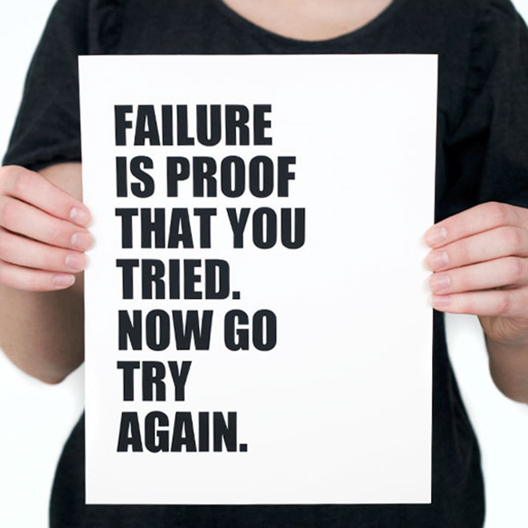
Attitude Toward Failure
•Everyone fails from time to time.
•Do you punish or treat it as part of learning?
•Failure can not be avoided. It is necessary learning that must occur.

Slide 55

Don’t bite off more than you can chew

Slide 56

Key Components
•Keep it simple
•If it is measured, it is improved
•Use the data for improvement
•Keep it simple
•Assessment must be used
•Multiple measures over multiple times
•Valid, reliable, and useable
•USE THE PROPER SYSTEMS AND TERMS

Slide 57
Change Process Planning Protocol
Originator: Date:
Question: | Answer:
Begin with the end in mind- describe the desired change: (vision)
Why this change is needed: (vision)
What the change will look like if successful:

Slide 58
Question: | Answer:
Possible unintended consequences:
Timeline for completion: (incentives)
Those to be involved and their roles:
What skills (training) and resources will be needed
Other stakeholders:
Active participants:
Role(s) in the change process

Slide 59
Steps needed to accomplish the change:(action plan)
Ongoing status notes:

Slide 60
Recommended Bibliography
Leadership and Change
Leadership
Brown, Roediger III, McDaniel. Make it Stick. 2014. Belknap Harvard
Collins. Good to Great. 2001. Harper-Collins.
Combs, Miser and Whitaker. On Becoming a School Leader. 1999. ASCD Press
Cottrell. Monday Morning Leadership. 2002. Cornerstone Press.
DePree. Leadership Jazz. 1992. Doubleday.
Dweck. Mindset. 2016 Ballantine Books.
Gladwell. Blink. 2005. Back Bay Books.
Gladwell. David and Goliath. 201. Back Bay Books.
Gladwell. Outliers. 2008. Back Bay Books.
Gladwell. The Tipping Point. 2002. Back Bay Books.
Glanz. Finding Your Leadership Style. 2002. ASCD Press
HBR’s 10 Must Reads on Leadership Style. 2011 Harvard Business School Press
Hougard and Carter. The Mind of the Leader. 2018. Harvard Business Review Press
Johansson. The Medici Effect. 2006 Harvard Business Review Press
Keller. The One Thing. 2012. Bard Press
Kise. Intentional Leadership: 12 Lenses. 2013. Tiple Nickel Press
Kouzes and Posner. The Leadership Challenge. 2002 Jossey-Bass.
Kouzes and Posner. The Truth About Leadership. 2010 Jossey-Bass

Slide 61
Recommended Bibliography
Leadership and Change Cont.
Mattone. Intelligent Leadership. 2013 American Management Association Press
Leadership Secrets of Santa Claus. 2003. Walk the Talk Press
Leadership and Self-Deception. 2010. Arbinger Press
Marzano, Waters and McNulty. School Leadership that Works. 2005. ASCD Press
Maxwell. The 21 Irrefutable Laws of Leadership. 2007. Thomas Nelson Press
Maxwell. The 21 Indispensable Qualities of a Leader. 1999. Thomas Nelson Press
McChesney, Covey and Juling. The 4 Disciplines of Execution. 2012. Free Press
Pink. Drive. 2009. Riverhead Books
Prince and Figliuolo. Lead Inside the Box. 2015. Career Press.
Rath and Conchie. Strengths Based Leadership. 2008 Gallup Press
Senge. The Fifth Discipline. 1990. Doubleday.
Sousa. Brainwork: The Neuroscience Behind How We Lead Others. 2012. Triple Nickle
Wheatley. Leadership and the New Science. 1992. Berrett-Koehler
Stiles. Team Leaders Toolkit. 2008. Skillpath Publications
Ziglar. Top Performance. 1986. Revell

Slide 62
Recommended Bibliography
Leadership and Change
Change
Aaron and Nelson. The Eight Constants of Change. 2008. Change Guides LLC
C-BAM (Concerns Based Adoption Model). Printed Materials.
DeBoer. Working Together Through the Seasons of Change. Workshop Materials
Duncan. Change-Friendly Leadership. 2012 Maxwell Stone Publishing
Fullan. Change Forces. 1993. Braun-Brumfield
Fullan. Deep Leadership: Maximizing Impact. 2017. IASCD Presentation
Fullan. Managing Change. Workshop Materials.
Orsi. Access-The Human Side of Change. Workshop Materials.
Reeves. Leading Change in Schools. 2009. ASCD.
Johnson. Sustaining Change in Schools. 2005. ASCD
Porto. Leading Major Change in Education. What the Beatles Can Teach Us. 2017.
IASA-DuPage Presentation

