Slide 1
Restorative Responses to Student Absenteeism: An Exploration of Racial Microaggressions

Slide 2
Learning Objectives
To inform participants of varying ways that racial microaggressions may influence the implementation of state and district attendance policies
To engage participants via small group discussions regarding the racial microaggressions which impact their respective school district’s implementation of attendance policies
To demonstrate the effectiveness of restorative practices in addressing racial microaggressions and chronic absenteeism

Slide 3
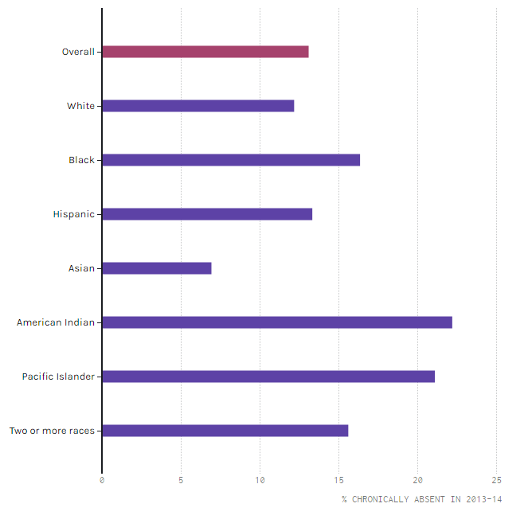
Race Disparities in Chronic Absenteeism
Department of Education
WHITE STUDENTS 14. 5 %
HISPANIC STUDENTS 17.0 %
BLACK STUDENTS 20.5 %
Compared to their white peers, Black students are 40 percent more likely to miss three weeks of school
Similarly, Hispanic students are 17 percent more likely to miss three weeks of school.
American Indian and Pacific Islander students are over 50 percent more likely to miss three weeks of school.
Notes:
While race disparities related to chronic absenteeism are prevalent across the country, students of different races and ethnicities experience chronic absenteeism at different rates. For example, statistics show the following:

Slide 4
Race Disparities in Chronic Absenteeism
State of Virginia
WHITE STUDENTS 9.5 %
HISPANIC STUDENTS 12.8 %
BLACK STUDENTS 13.1 %
Alexandria City Public Schools
WHITE STUDENTS 5.0 %
HISPANIC STUDENTS 10.3 %
BLACK STUDENTS 7.7 %

Slide 5
Potential Harm:
Legal Consequences
Student Impact
Parent Impact
School Based Attendance Conferences
Community, Inter-Disciplinary Team Meetings
Juvenile Probation And Court Supervision
Out-of-Home Placement
Juvenile Detention Center
Suspension / Revocation Of Student’s Driver’s License
First Offense: Class 3 misdemeanor, punishable by up to $500.00 in fines.
Second or Subsequent Offense: Class 2 Misdemeanor, punishable by up to 6 months in jail and/or a $1,000 fine.
Notes:
School attendance is mandatory for all students between the ages of 5 and 17 in the State of Virginia. Per VDOE and State Attendance laws, varying interventions and sanctions must take place for students and families who are chronically absent from school. However, given recent attendance data regarding race disparities, it is critical to assess the potential harm these sanctions may specifically have on students of color.

Slide 6
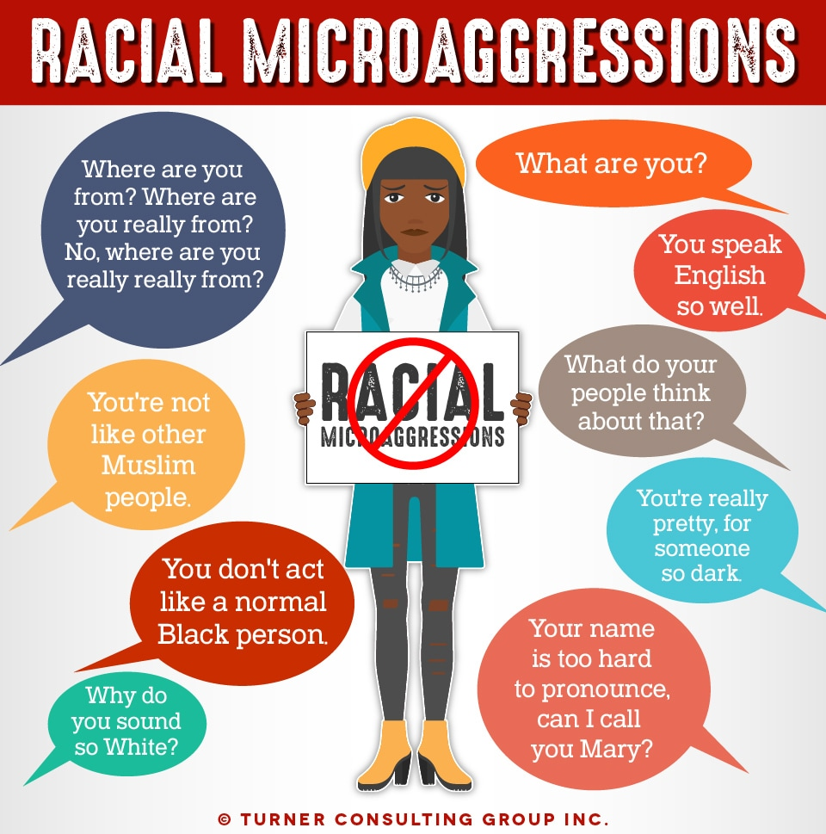
Potential Harm:
Microaggressions
Racial disproportionalities in attendance data are often embedded in threads of racial microaggressions in school settings. Although microaggressions are transmitted in indirect ways, they are often pervasively evidenced at varying levels of operation.

Slide 7
Racial Microaggressions
Primary Categories
Examples
Micro assault - Communicates an intentional message of hate or insult
Micro invalidation - Subtly diminishes and minimizes the experiences, values, feelings, or potential
An administrator states in a staff meeting that Hispanic students are always absent from school because they are illegal immigrants and gang bangers who do not believe in education
Hakeem, a 4th grader from Kenya, has missed 6 days of school. During the attendance meeting with his mom, it is discovered that Hakeem has been afraid to come to school because he has been bullied by classmates for wearing clothing that is representative of his home country. The teacher informs the mother that the best remedy for this matter is to buy him more trendy, American clothing.
Notes:
Racial microaggressions are the brief but commonplace insults, indignities and denigrating messages sent to students of color by well-intentioned white staff who are unaware of the harm in the hidden messages they communicated.

Slide 8
Categories Of Racial Microaggressions
Primary Categories
Examples
Micro insult - Both verbal and nonverbal messages that elusively communicate an insult, offense or invalidation
  The Geometry teacher is submitting referrals for her 10th grade students who have chronic attendance issues. The referral for Rihanna, an African American student, was sent to the school’s attendance officer and the In- School Suspension teacher, while the referral for Brittany, a white student, was sent to the school counselor.

Slide 9
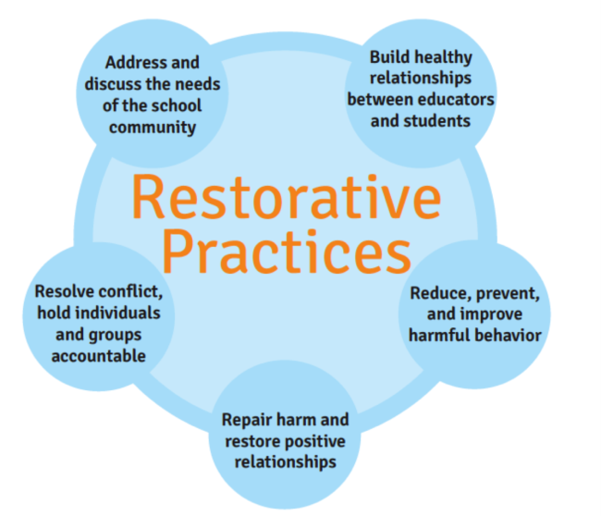
Benefits of Restorative Practices

Slide 10
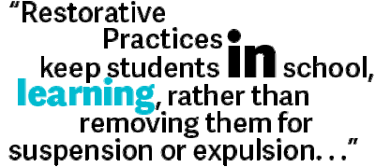

Slide 11
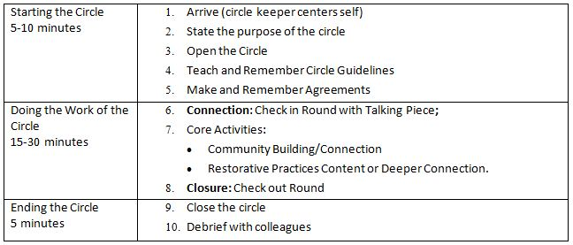
Engaging in the Work
The 4 Agreements of Courageous Conversation
Community Circle Questions about Microaggressions

Slide 12
The Four Agreements of Courageous Conversations
Stay engaged: Staying engaged means “remaining morally, emotionally, intellectually, and socially involved in the dialogue.”
Experience discomfort: This norm acknowledges that discomfort is inevitable, especially, in dialogue about race, and that participants make a commitment to bring issues into the open. It is not talking about these issues that create divisiveness. The divisiveness already exists in the society and in our schools. It is through dialogue, even when uncomfortable, the healing and change begin.
Speak your truth: This means being open about thoughts and feelings and not just saying what you think others want to hear.
Expect and accept nonclosure: This agreement asks participants to “hang out in uncertainty” and not rush to quick solutions, especially in relation to racial understanding, which requires ongoing dialogue.

Slide 13
Community Circle Questions
1. What is your understanding of racial microaggressions?
2. Do you believe that racial microaggressions have an impact on your and other students’ belief in themselves to succeed in school?
3. Do you feel that school attendance policies impact Black students differently than other racial groups?
4. Do you believe that student absences and related policies impact your and other students’, belief in themselves to succeed in school? Please describe.

Slide 14


Slide 15
Contact
Alexandria City Public Schools Department of Student Services,
Alternative Programs and Equity
703-619-8034
Ms. Tara Newton, LCSW
Truancy Outreach Specialist
tara.newton@acps.k12.va.us
Mr. Gregory Baldwin, M.Ed.
School Climate and Culture Specialist
gbaldwin@acps.k12.va.us

